Slide 1
CMPE 202- Software Systems Engineering Team Project Presentation
Rent-A-Car
By
Geethu Padachery
Monica Dommaraju
Shree Gowri Radhakrishna
Sri Sruthi Chilukuri

Slide 2
High-level Requirements
Rent-A-Car web application
Authenticated Login/ SignUp
Check vehicle availability
Reserve, cancel return vehicles
Add locations, vehicles, vehicle type
Check account information, terminate account
Manage users, terminate user

Slide 3
Role Management
Screen | Admin Access | User Access
Login | Yes | Yes
Home | Yes | Yes
Register User | Yes | Yes
Location | Yes | No
Vehicle | Yes | No
VehicleType | Yes | No
ManageUser | Yes | No
Reservation | Yes | Yes
Account | Yes | Yes

Slide 4
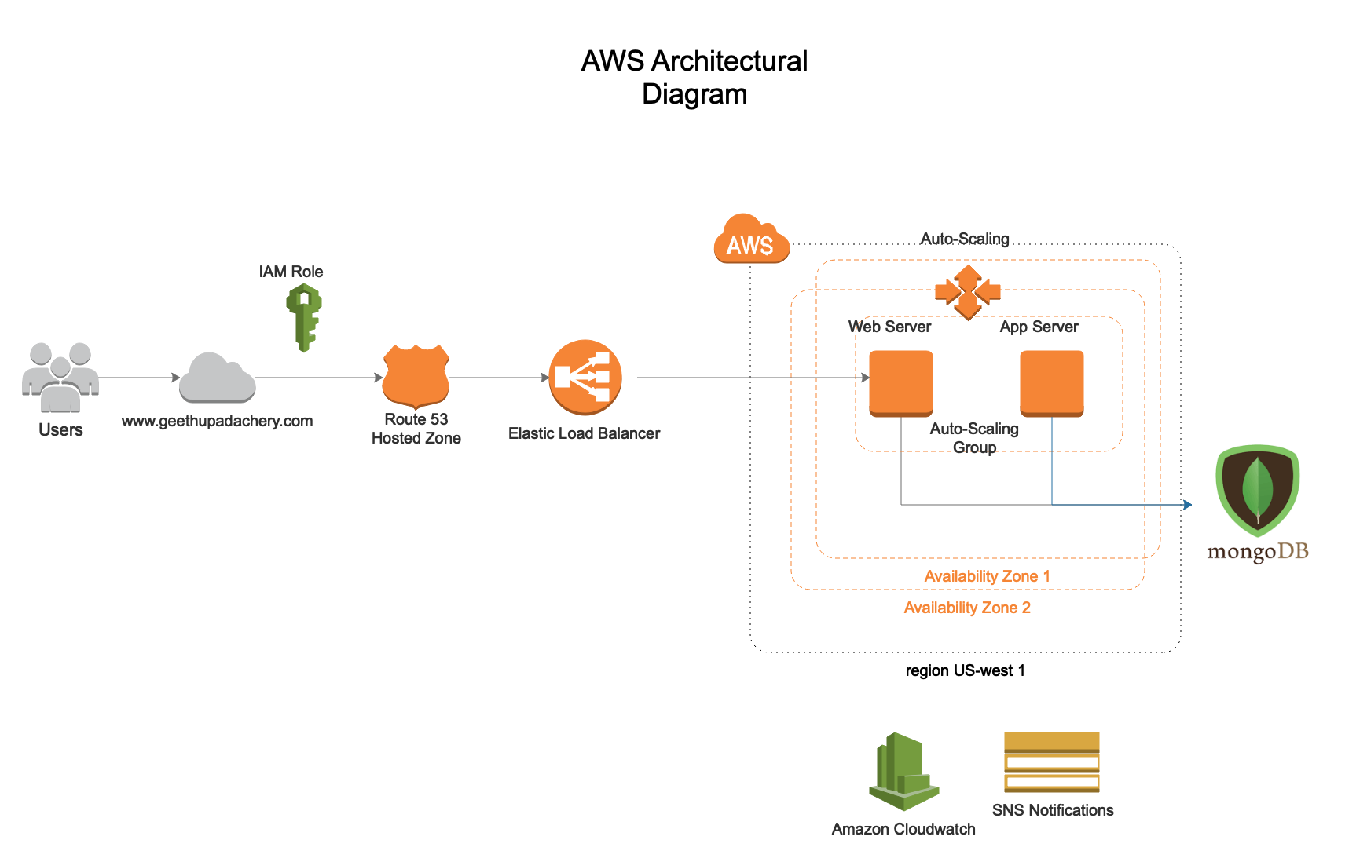
Design (Architecture diagram)

Slide 5
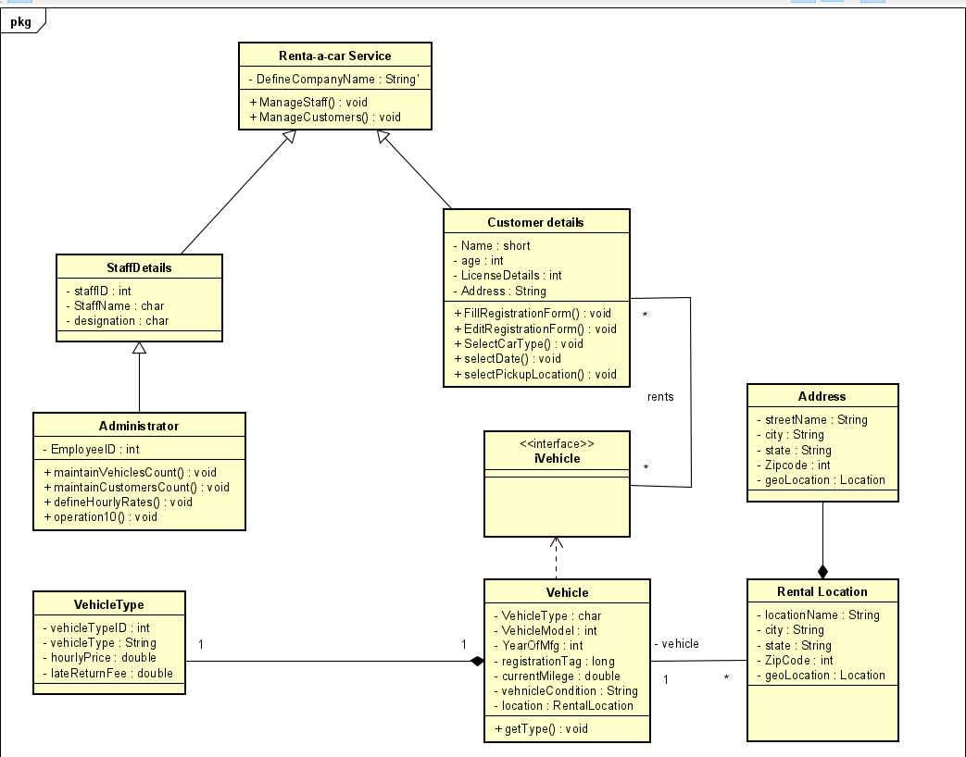
Class Diagram

Slide 6
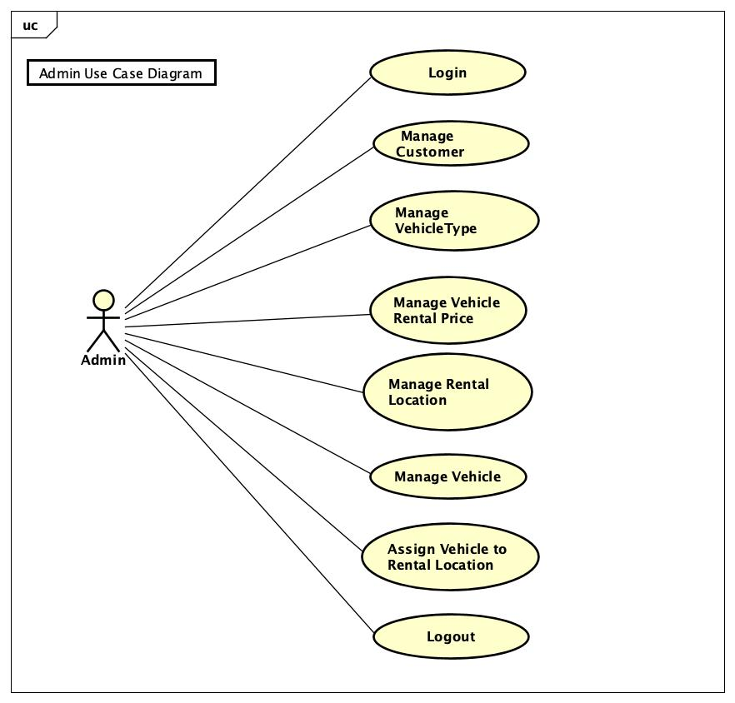
Use case Diagram
(Admin)

Slide 7
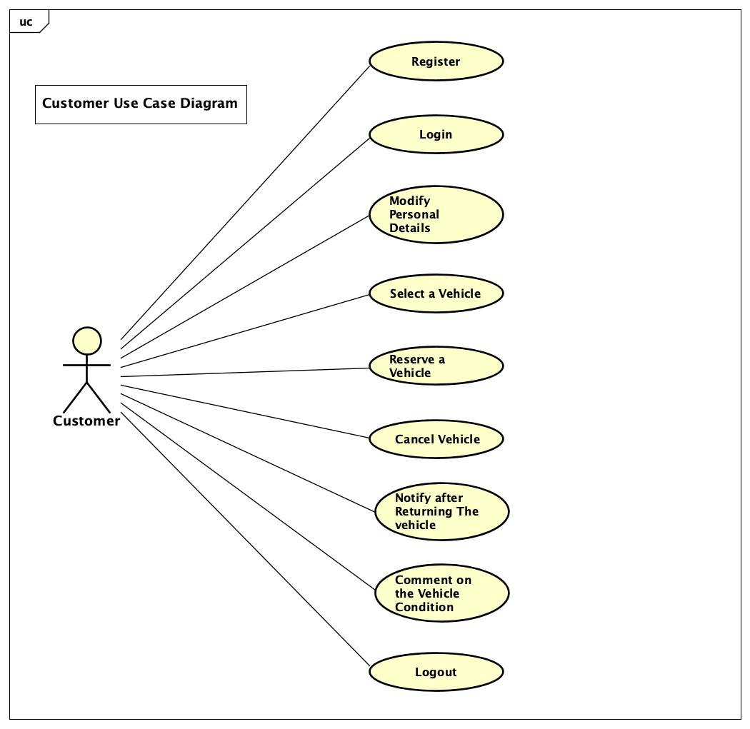
Use case Diagram
(User)

Slide 8
Components of the Application
Admin
User
Vehicle
Rental Location
Reservation
Address

Slide 9
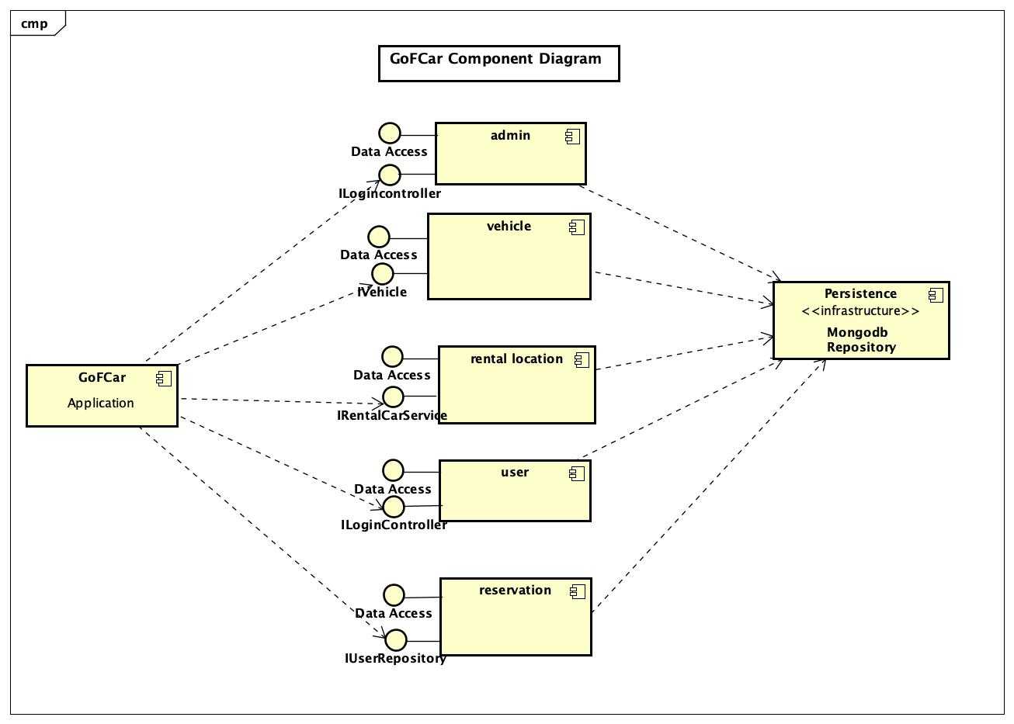
Component Diagram

Slide 10

Technology Stack

Slide 11
Deployment
//Todo

Slide 12
Thank you!

